Slide 1
Primality Testing
Fermat’s Theorem
&
Euler’s Theorem

Slide 2
Primality Testing
It is an algorithm for determining whether the given input is prime or not.
Algorithm:
  Fermat’s Theorem
  Euler’s Theorem

Slide 3
Fermat’s Theorem

Slide 4
Fermat’s Theorem
(Fermat’s Primality Test)
It is a probabilistic test to determine whether a number is a probable prime.
It states that, if ‘n’ is a prime number, then for every ‘a’, 1 < a < n-1, then
a^{n-1} ≡ 1 (mod n)
(or)
a^{n} / a ≡ 1 (mod n)
a^{n} ≡ a (mod n)
If a^{n-1} ≡1(mod n), then we declare ‘n’ is the probable prime number.
If a^{n-1} ≡1(mod n), then we declare ‘n’ is the composite number.
A number may pass the Fermat’s test but not a prime, then the number is a Carmichael number.

Slide 5
Example - 1
Is 5 prime?
Solution:
  Check a^{n-1} ≡1(mod n) [or] a^{n-1} % n = 1 for every ‘a’, 1 < a < n-1
  Given n = 5
  pick 1 < a < 4
  2⁴ ≡ 1 (mod 5) [or] 2⁴ % 5 = 1
  3⁴ ≡ 1 (mod 5) [or] 3⁴ % 5 = 1
  4⁴ ≡ 1 (mod 5) [or] 4⁴ % 5 = 1
  Here the condition is always true, therefore the given number 5 is prime.
True for all the cases

Slide 6

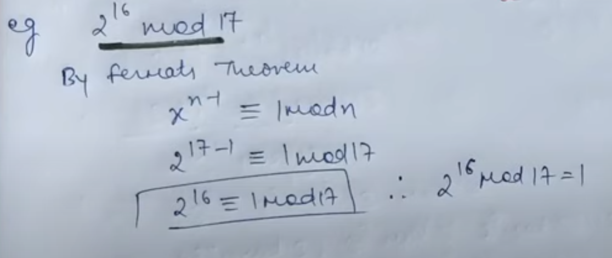

Slide 7
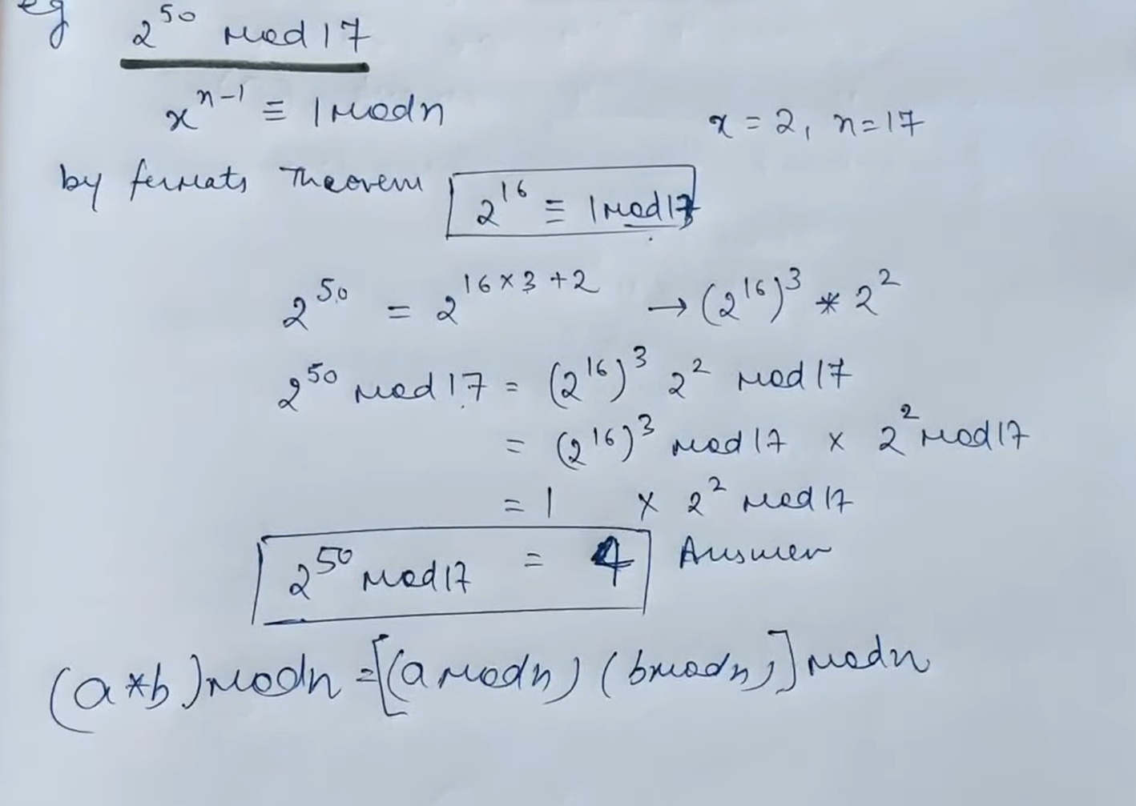

Slide 8
Algorithm
Inputs: n - a value to test for primality where n>3;
k - a parameter that determines the number of times to test for primality.
Output: composite if ’n’ is composite, otherwise probably prime.
Repeat k times:
  Step 1: Pick ’a’ randomly in the range [2, n − 2]
  Step 2: If a^{n-1} ≡1(mod n), then return composite.
  Step 3: If composite is never returned then return probably prime.
  NOTE: The a values 1 and n-1 are not used as the equality holds for all n and all odd n respectively, hence testing them adds no value.

Slide 9
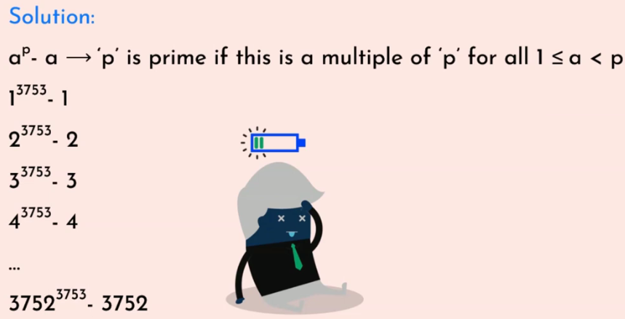
Drawbacks of Fermat’s theorem
Complex for large numbers.
Example: is 3753 prime?

Slide 10
Drawbacks of Fermat’s theorem
Lack of accuracy.
Example: is 561 prime?
  Actual answer is 561 is a composite number and not a prime number, but Fermat’s primality test will say 561 is a prime number.

Slide 11
Exercise
Find whether 11 is prime using Fermat’s theorem.

Slide 12
Euler’s Totient (Phi) function

Slide 13
Euler’s Totient (Phi) function
Denoted as φ(n).
φ(n) = Number of positive integers less than ‘n’ that are relatively prime to ‘n’ .
Counts the number of integers between 1 and n which are co-prime to n.
NOTE: x and y are co-prime if GCD(x,y)=1

Slide 14
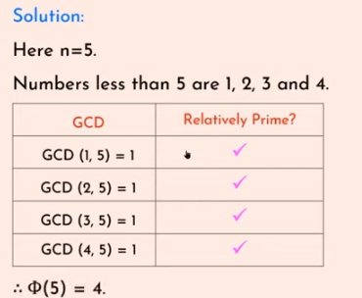
Example - 1
Find φ(5).

Slide 15
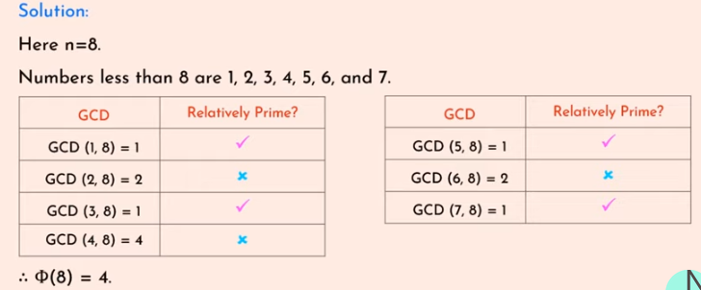
Example - 2
Find φ(8).

Slide 16
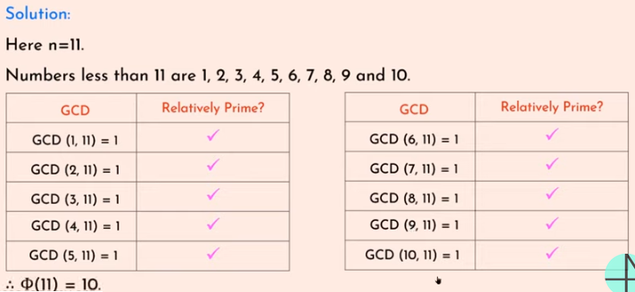
Example - 3
Find φ(11).

Slide 17
Exercise
Find φ(369) and φ(372).

Slide 18
Properties of Euler’s Totient Function
If p is a prime number, then Φ(p) = p -1
Example:
Find Φ(7).
Here 7 is a prime number then
Φ(7) = 7-1
= 6.

Slide 19
Properties of Euler’s Totient Function
2. If p is a prime number and k>=1, then
Φ(p^{k})=p^{k}-p^{k-1}
Example:
Find Φ(8).
Φ(8) = Φ(2³) = 2³-2³⁻¹
= 8 - 4
= 4

Slide 20
Properties of Euler’s Totient Function
3. If a and b are relatively prime
Φ(ab)= Φ(a)* Φ(b)
Example:
Find Φ(15).
Φ(15)= Φ(3)* Φ(5)
= 2*4
= 8

Slide 21
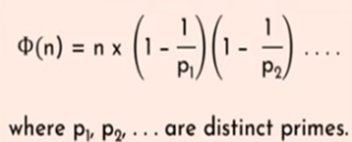
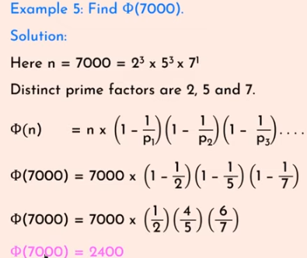
Properties of Euler’s Totient Function
4. If n = a x b, then either a or b is composite. Both are a and b are composite.
=2

Slide 22
Exercise
Φ(20)
Φ(21)
Φ(19)
Φ(45)
Ans
Φ(20) = 8
Φ(21) = 12
Φ(19)= 18
Φ(45)=24

Slide 23
Euler’s Theorem

Slide 24
Euler’s Theorem
Euler’s theorem states that for every possible integers ‘a’ and ‘n’ are said to be co-prime then,
a ^{Φ(n)} ≡ 1 (mod n )
Example:
Prove Euler’s theorem hold true for a=3 and n=10.
  Given a=3 and n=10
  Step 1. Check a ^{Φ(n)} ≡ 1 (mod n ), then 3^{Φ(10)} ≡ 1 (mod 10)?
  Step 2. Find Φ(10) = Φ(2) * Φ(5) = 1*4 = 4
  Step 3. 3⁴ ≡ 1mod 10
  Step 4. 81 ≡ 1 mod 10
  Step 5. 1 = 1
  Therefore, Euler’s theorem holds true for a=3 and n=10.

Slide 25
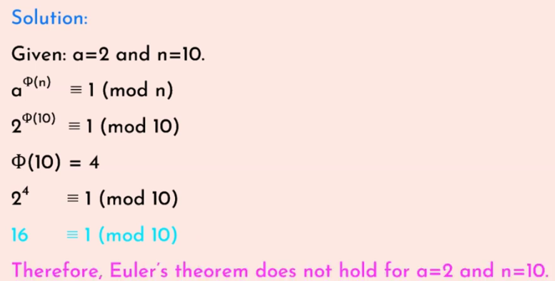
Example - 2
Does Euler’s theorem hold true for a = 2 and n = 10.

Slide 26
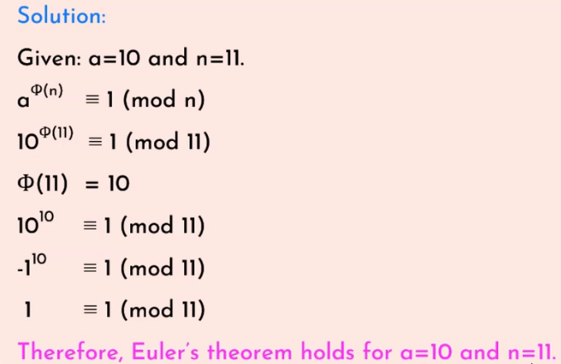
Example - 3
Does Euler’s theorem hold true for a = 10 and n = 11.
Notes:
10 is -1 shortage from 11 so we cant write it as -1¹⁰ ≡ 1 (mod 11) and -1 to the power odd number v ll get -1 itself since -1 to the power even number

Slide 27
Exercise
Prove Euler’s theorem does not hold for a = 11 and n = 33.

